Slide 1
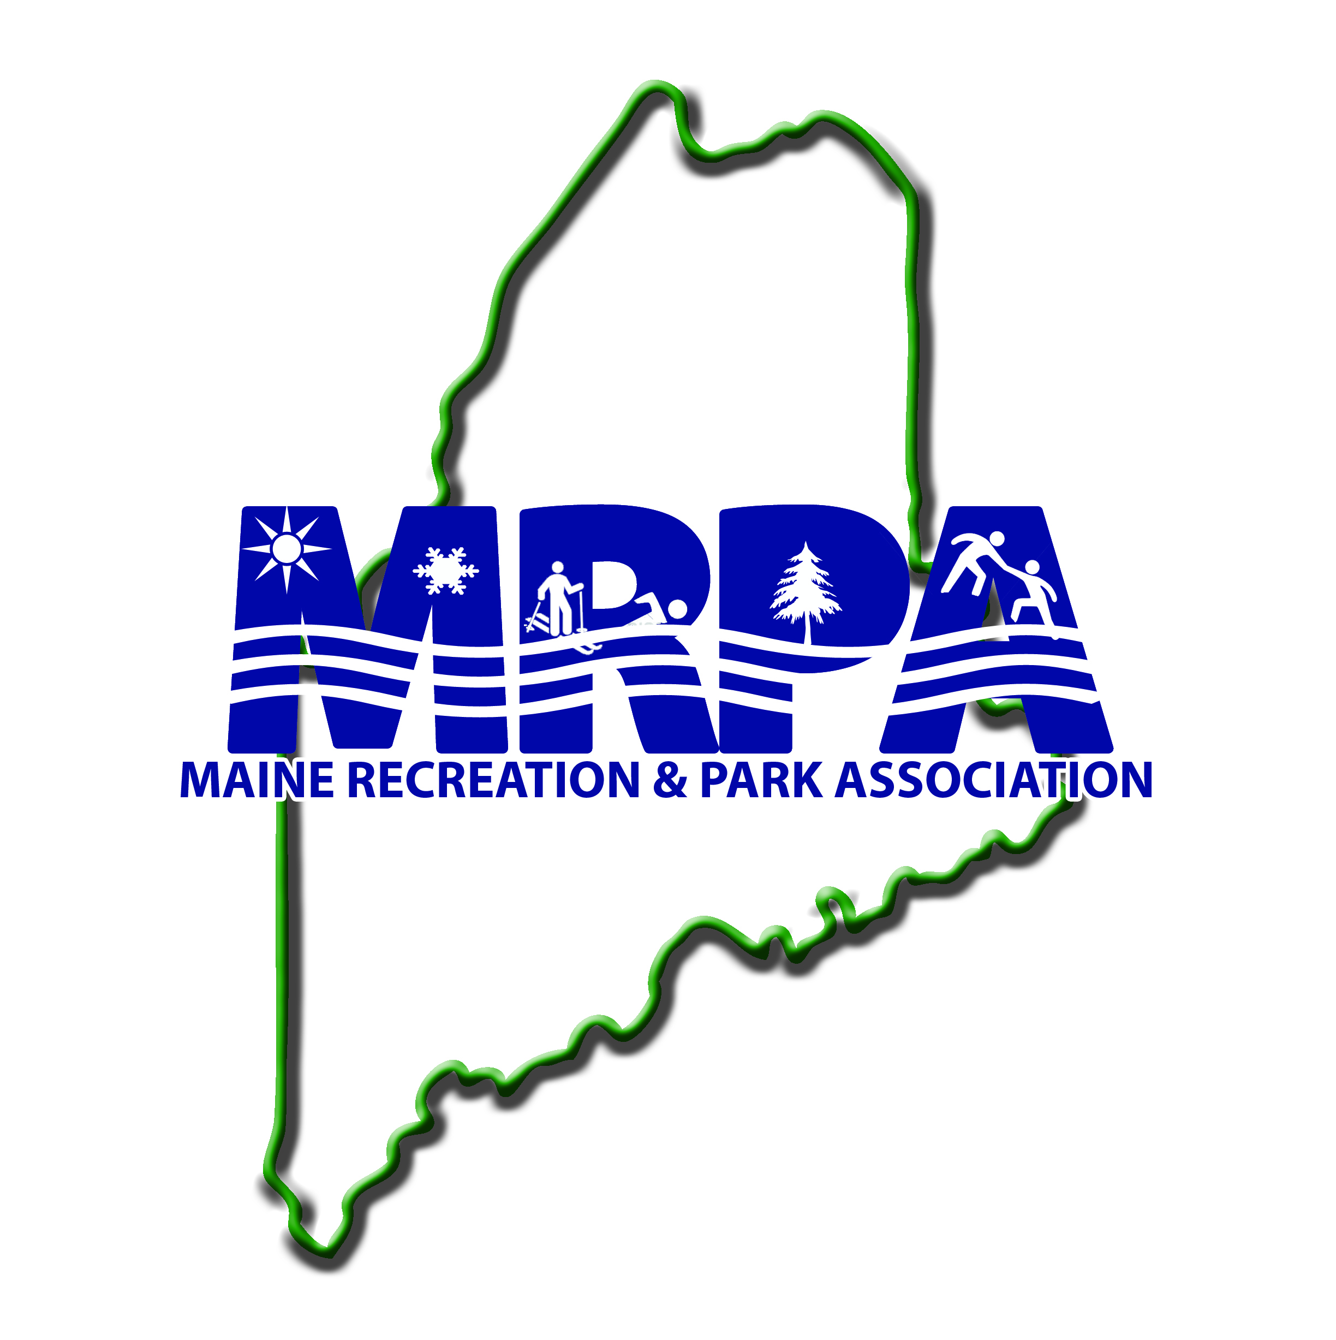
"William V. Haskell" Distinguished Professional of the Year Award

Slide 2
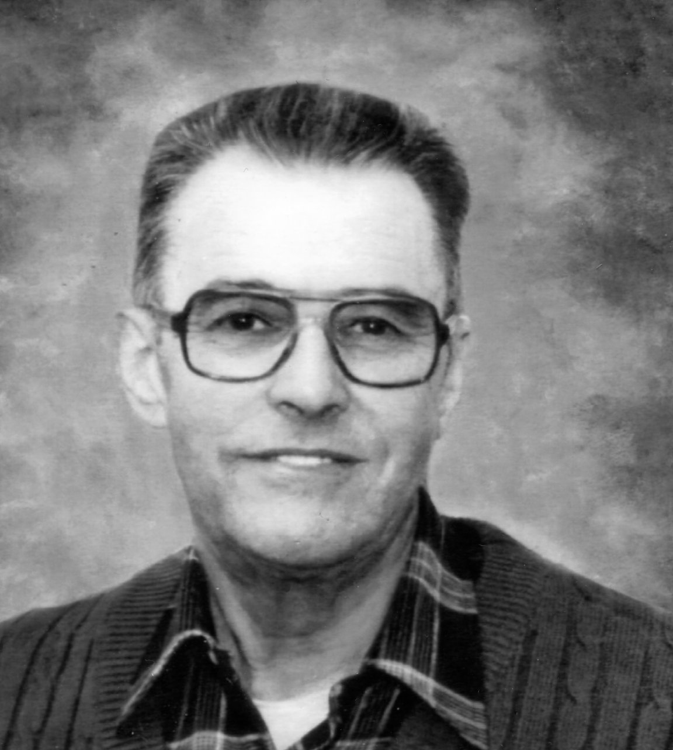
William V. Haskell
1914 – 1986
Director of
Presque Isle
Parks & Recreation
from 1946-1981

Slide 3
Who was Bill Haskell? A graduate of Aroostook State Normal School (now U.M.P.I.) and the University of Maine (Orono) who served four years in the U.S. Army Air Corps

Slide 4
Who was Bill Haskell? * The City of Presque Isle’s first Eagle Scout, and first full-time recreation director. * His salary was paid by the United Way and Community Association funds. * In 1963, the City funded the position, believed to be the first in the State.

Slide 5
Accomplishments of Bill Haskell? * An organizer and charter member of both the Northern Maine Community Recreation Association and the Maine Recreation & Parks Association * Author of Recreation – A Lifetime Adventure: A History of Presque Isle Recreation Programs from 1920’s – 1982.

Slide 6
Parks & Facilities Under Bill’s Direction (many firsts in Maine): *Northern Maine Forum *Indoor pool & 1 million gallon outdoor pool - one of the largest in New England *Multi-purpose field and tennis courts on the NMCC campus * 6 lighted tennis courts on UMPI campus

Slide 7
Parks & Facilities Under Bill’s Direction (many firsts in Maine): * Outdoor skating rink & warming hut * 1st lighted SOFTBALL field in New England * Mantle Lake Park & tennis courts * Arnold Brook Lake, Veterans’ Park, Riverside Bi-Centennial Park, Bike Paths, Peace Park, Double Eagle Balloon site, outdoor basketball courts

Slide 8
How is Bill Remembered?
Many described him as a great leader, mentor, and friend
Some referred to him as, “The Haskell School of Parks & Recreation”
MRPA still honors him through annual recognition of other distinguished professionals in Parks & Recreation

